Slide 1
How are family planning and urban development linked?
Dr James Duminy
University of Bristol and University of Cape Town
Africities Summit, Kisumu (Kenya)
18 May 2022

Slide 2
Introduction
International Union for the Scientific Study of Population (IUSSP) Family Planning, Fertility and Urban Development programme, funded by Gates Foundation
‘State of the art’ literature review conducted on links between urban development, family planning (FP)and fertility change
Report on ‘influencing the urban policy agenda’, based on interviews with international urban policy experts

Slide 3
5 key messages
Urbanization in Africa as a demographic AND an economic process
Urbanization and fertility decline in Africa
How to deliver safe, quality FP will differ between cities and across parts of cities
Role of mayors and local government leaders
Better data, observation and monitoring systems for economic development

Slide 4
Urbanization in Africa is a demographic AND an economic process
Over half of urban population growth in LMICs is due to natural increase rather than rural-urban migration
Urbanization is not simply a natural byproduct of economic development
Urbanization (past and present) is better understood as a demographic process, particularly to account for urbanization without economic growth
Whether urban growth is driven by migration or natural increase has significant implications for spatial development policy

Slide 5
Urbanization promotes fertility decline, but fertility stalls have emerged in some contexts
Urban fertility stalls identified for a number of African countries
Urban fertility rates have stalled in ~50% of African capital cities (@ an average of 3.4 children per woman)
Recent increases in a few countries (e.g. Nigeria, DRC, and Tanzania)
In other urban areas, stalls apparent in about 1/3 of countries

Slide 6
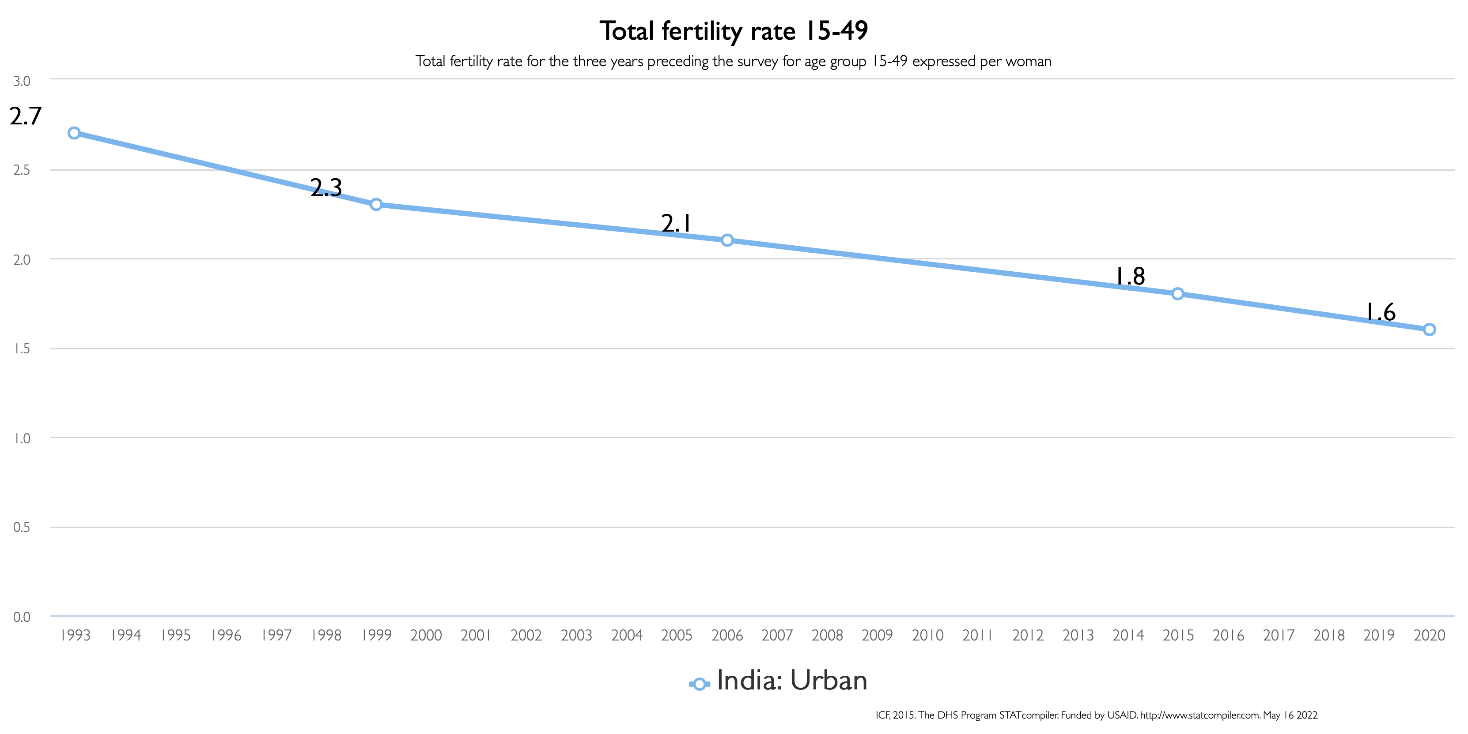
India

Slide 7
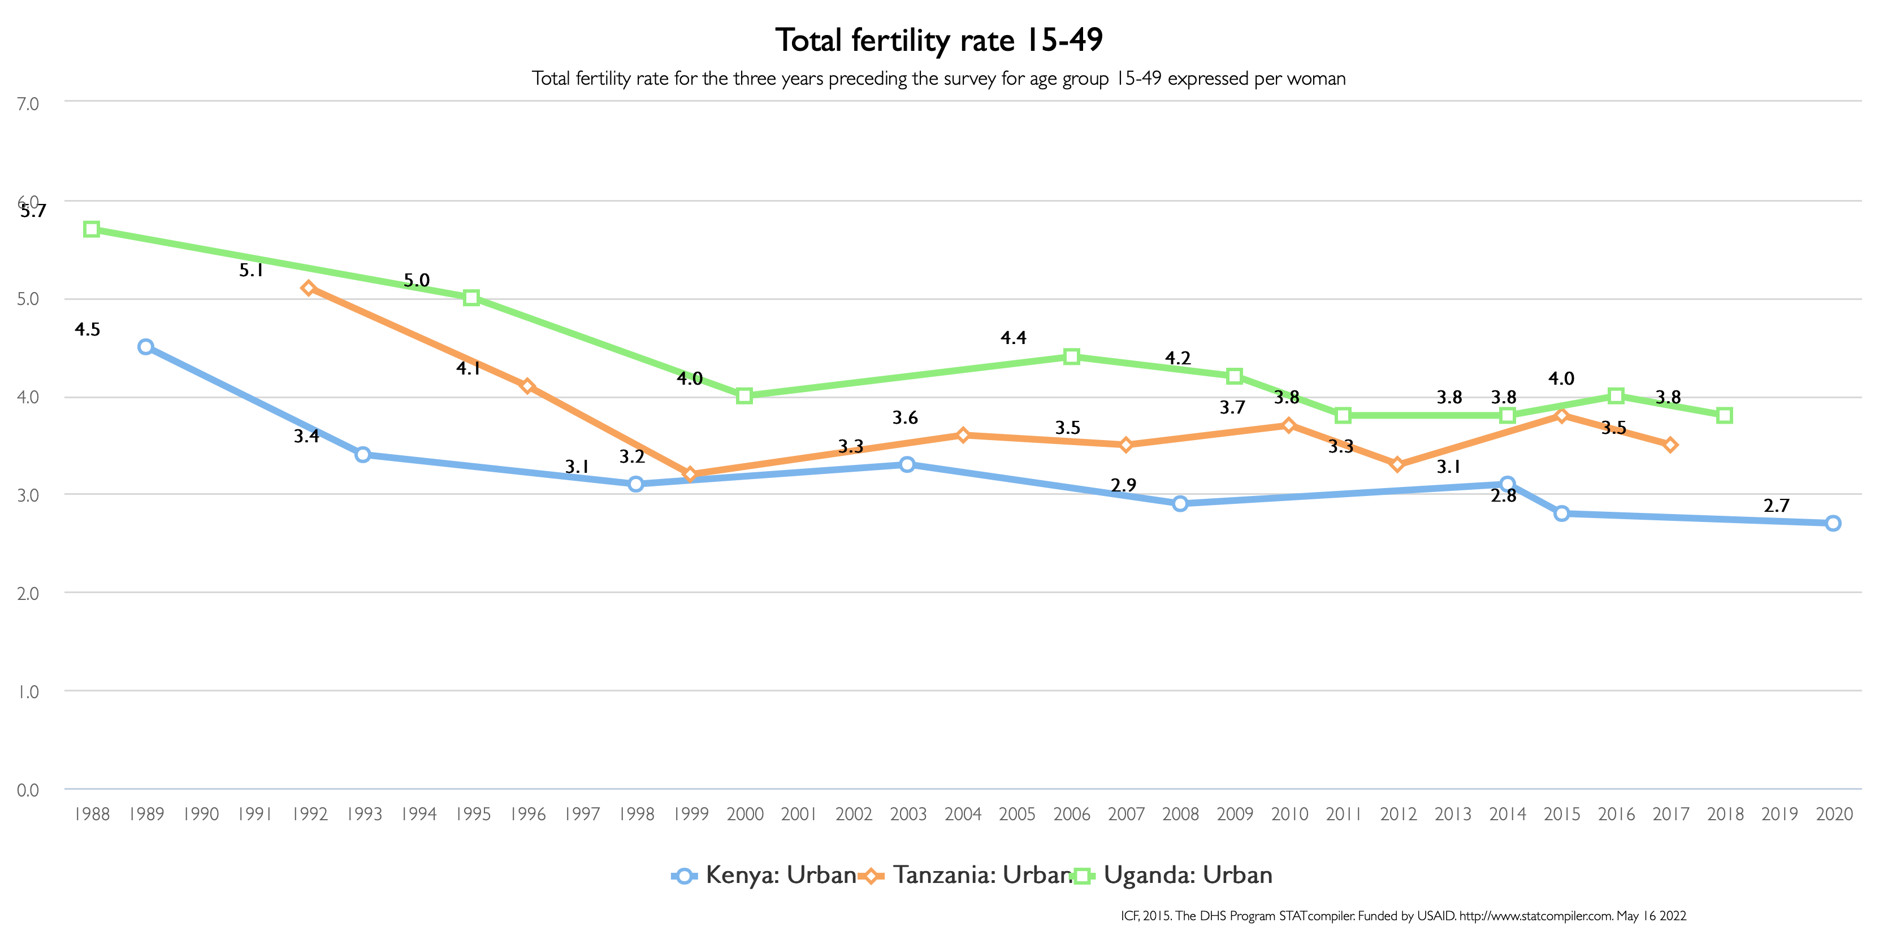
Uganda
Tanzania
Kenya

Slide 8
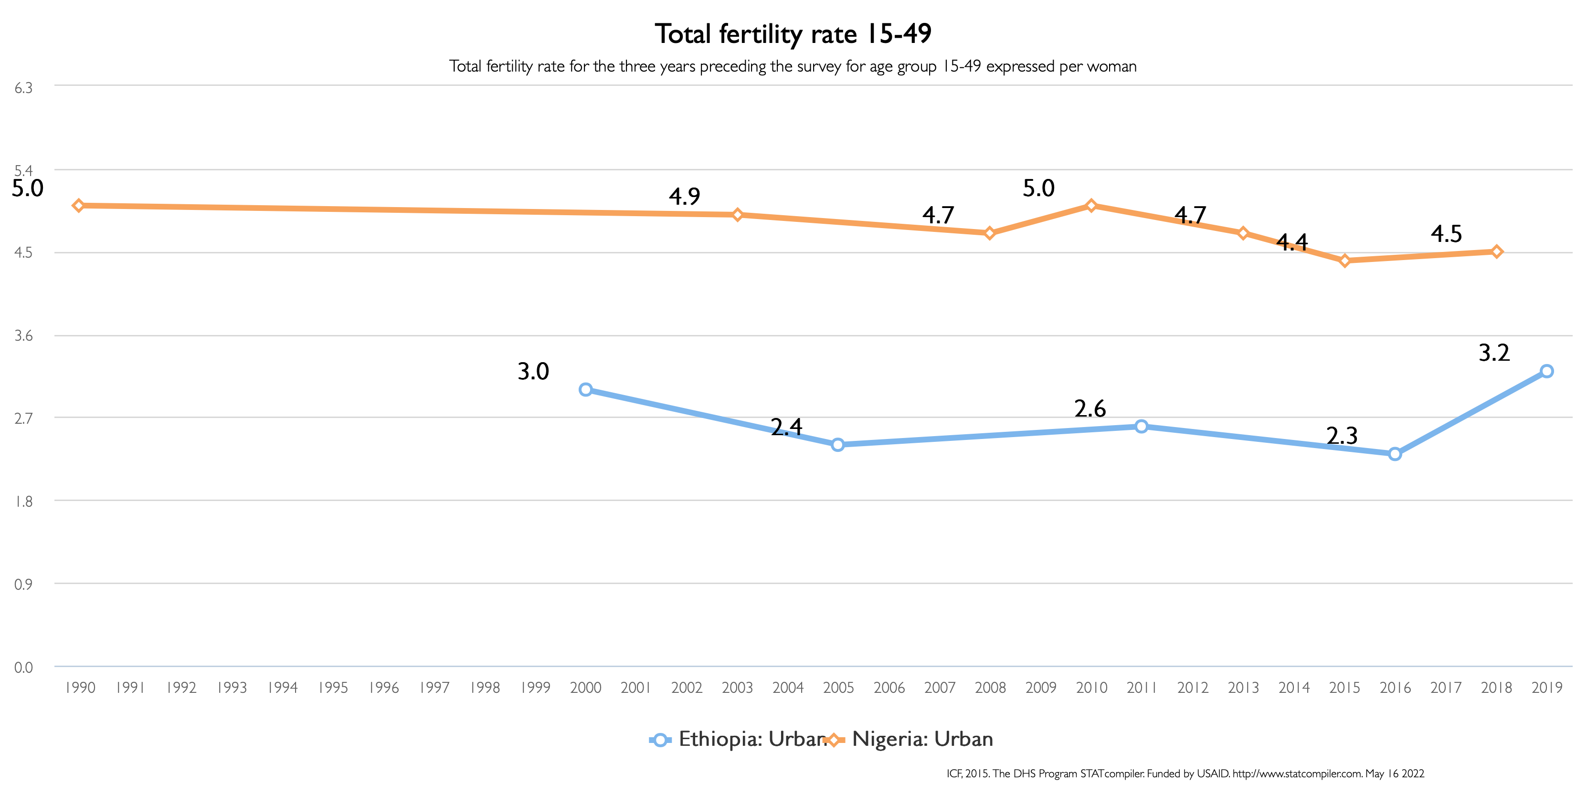
Nigeria
Ethiopia

Slide 9
Urbanization promotes fertility decline, but fertility stalls have emerged in some contexts
Urban fertility stalls identified for a number of African countries
No clear urban and rural patterns in fertility stalls/increases

Slide 10
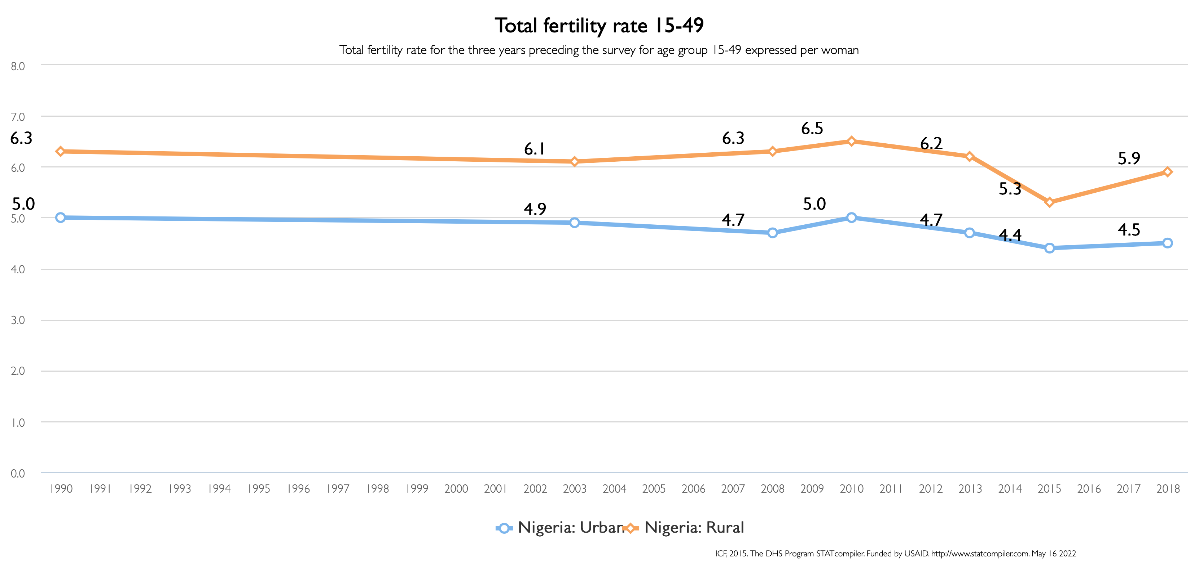
Nigeria rural
Nigeria urban

Slide 11
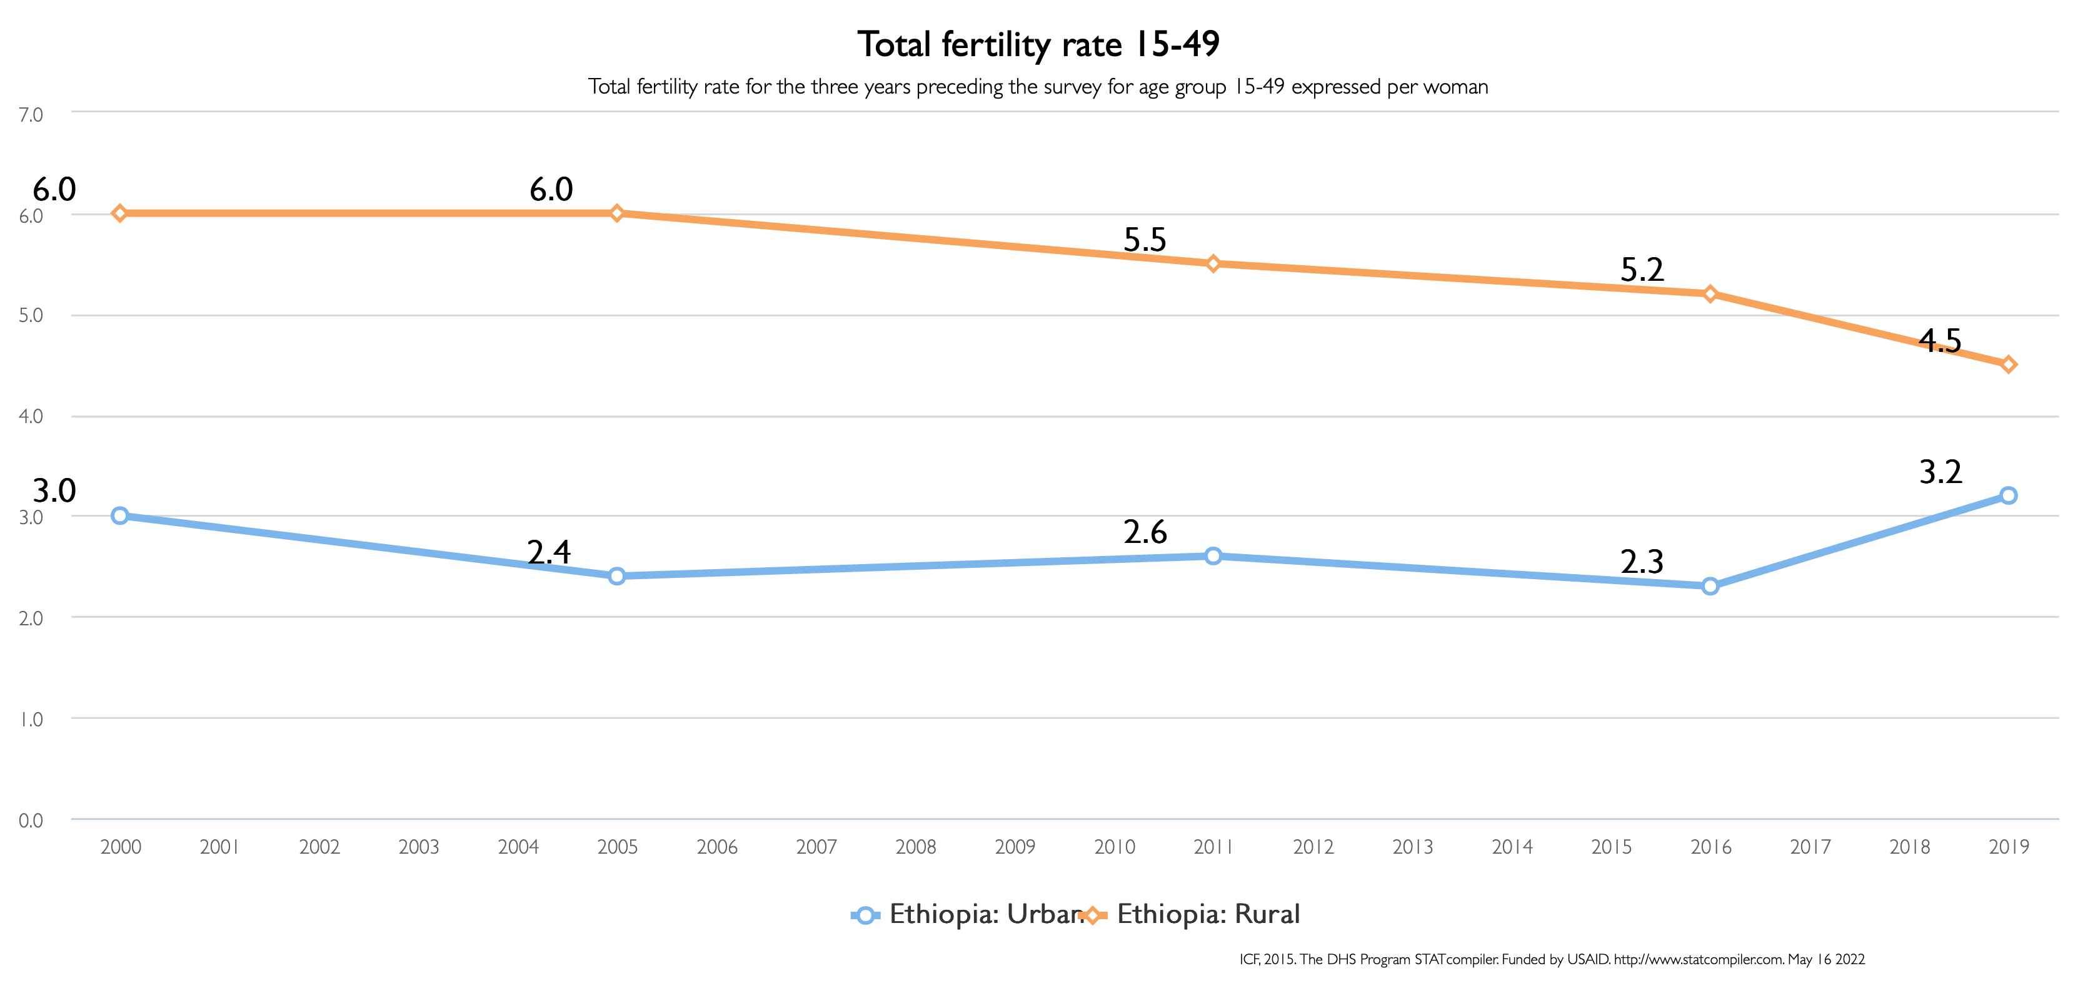
Ethiopia rural
Ethiopia urban

Slide 12
Urbanization promotes fertility decline, but fertility stalls have emerged in some contexts
Urban fertility stalls identified for a number of African countries
No clear urban and rural patterns in fertility stalls
What specific factors are driving these differentiated trends? No consensus, but possibly:
Declining national and international support for FP programmes from 1990s
High levels of desired fertility related to socioeconomic uncertainty
Disruptions to female education linked to the effects of economic crises (and structural adjustment programmes) of the 1980s and 1990s

Slide 13
Urbanization promotes fertility decline, but fertility stalls have emerged in some contexts
Fertility stalls = continued (rapid) rates of urban growth
Will perpetuate higher levels of poverty while placing pressure on housing stocks and other urban services
Will impact how cities are managed, how much and where money is spent

Slide 14
How to deliver safe, quality FP will differ between cities and across parts of cities
Historically, government FP programmes have prioritized rural services
But in 10 out of 39 African countries with relevant data, unmet need is higher in urban areas than in rural areas
Patterns of unmet need in countries (e.g. Ghana) show significant geographic heterogeneity (Amoako Johnson et al., 2012)

Slide 18
How to deliver safe, quality FP will differ between cities and across parts of cities
There is a research bias towards larger cities and national urban-rural comparisons
We need to know more about trends in intermediate cities, peri-urban areas, etc.
Other
Large city
Multiple cities
Intermediate city
(n = 279)

Slide 19
Mayors can champion gender equity in their cities, and highlight the importance of safe, quality and affordable FP
Mayors can help provide an interface between local government and the healthcare system to assist with FP service delivery
Organized local government is a critical forum to raise the importance of FP within the international urban agenda (including post-SDG processes)
FP cannot be separated from the other services for which mayors and LGs have responsibility
FP is part of a wider suite of services that make cities work

Slide 20
For economic development, we need better data, observation and monitoring systems that include demographic trends
Promoting access to safe, quality and affordable FP is crucial to realizing the demographic dividend and driving economic development
For effective urban economic modelling, we need more accurate urban demographic data and more of a focus on urban demographic change
E.g. better demographic measurements needed to understand how different urban environments will change in economic positioning, opportunities, access to trade, etc.

Slide 21
For economic development, we need better data, observation and monitoring systems that include demographic trends
City data systems can play a lead role in integrating and spatializing data on health, finance, infrastructure services, etc.
We need more and better data for every kind of urban area
The need for accurate data and knowledge is especially acute for intermediate cities

Slide 22
The post-pandemic opportunity
The COVID-19 pandemic has helped to centre health within urban policy discussions (e.g. work of UN-Habitat)
But COVID-19 has also had the tendency to ‘crowd out’ issues not directly related to infectious disease
Direct references to FP do not feature prominently in ongoing discussions around urban health
Calls for a ‘whole health’ focus that looks at infectious diseases alongside other urban burdens of disease
May be necessary to scale-up an urban health agenda into national urban policies

Slide 23
Conclusion
We know a fair amount about urban FP, but there are geographic and thematic blind spots – like intermediate cities and the role of LGs
FP can play an important role in driving city economies and sustainability, but this requires better data for targeted interventions
We need to seize the opportunity to embrace an expanded urban health agenda that includes FP

Slide 24
Thank you
Contact: james.duminy@bristol.ac.uk
Duminy, J., Cleland, J., Harpham, T., Montgomery, M. R., Parnell, S. and Speizer, I. S. (2021) ‘Urban Family Planning in Low- and Middle-Income Countries: A Critical Scoping Review’. Frontiers in Global Women's Health 2: 749636. https://doi.org/10.3389/fgwh.2021.749636

