Slide 1
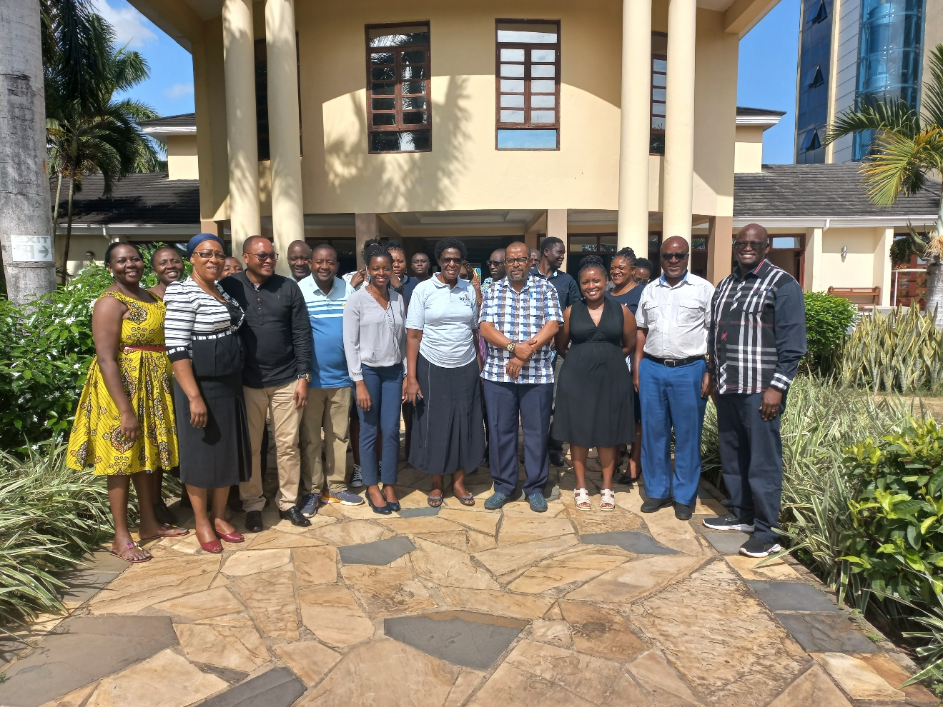
Political Leader as Champion of Family Planning
Abdulrahman Omary Shiloow: Hon Mayor Tanga City Council, Tanzania.

Slide 2
About Tanga City Council
Administrative and Geographical distribution
Among 6 Cities in Tanzania
Among 11 Councils in Tanga Region
Administratively, has 4 Divisions, 27 Wards and 181 strees
It is 600 square kilometers.
Its Population is around 352,000 people
Serves administratively as Headquater and commercial Center of Tanga Region

Slide 3
About Tanga City Council
Financial Opportunities
2nd largest port in the Country
Erable land for sisal cultivation
Reachable by rail, Ships, Aeroplan, roads
354 km to Dar es salaam(1st Commercial City of Tanzania)
165 km to Mombasa City (2nd Commercial City of Kenya)
Two mega projects to be launched recently
East Africa Crude oil project
Green and Smart City initiative

Slide 4
Health Facilities Coverage
Public Health Facilities
1 Council Hospital
9 Health Centers
19 Dispensaries
1 Community Pharmacy
Private Health Facilities
1 Hospital
2 Health Centers
12 Dispensaries
6 Polyclinics
23 Pharmacies
169 ADDOs

Slide 5
Council Financial Capacity
Annual Council Collection and expenditure: Tsh. 73,629,495,445
Annual Health Sector collection and Expenditure Tsh. 3,179,892,995
Fund Source | Sum (Tsh)
Own Source | 15,354,836,000
PE | 43,312,438,485
OC | 1,813,683,960
Development Grants | 13,148,537,000
Fund Source | Sum (Tsh)
Own Source | 2,669,000,000
Central Government | 510,892,995.74

Slide 6
Role of the Government
Tanga City Council plays its role in improving health care quality and safety to its people
Procure medical supplies including supplies for Family planning
Provide quality health care
Ensure access to quality care especially for vulnerable population

Slide 7
Why Tanga City Council has increasingly spending more in Family Planning
Tanga City believes that investing in Family Planning can improve the health of the population by:
Reduce maternal and neonatal death
Reduce teen pregnancies
Improve the health of the mother and family as well
Improve Family Social-Economic status by determining the number of Children the Family can afford to care

Slide 8
What Tanga City is trying to address pertaining to Family Planning, Sexual and Reproductive Health
Investing in infrastructure of Primary Health care in underserved
Tsh 1.3 Bil in Construction of 1 Health center and 5 Dispensaries all with Modern OPD, Placenta Pit, Incinerator and Staff Houses
Reduce delays to access health services
Capacitate service providers
Enable affordability of health services
Promote equity
Integration of services
Ensure supplies availability
Demand creation
FP/AYSRH education
Use of Community health workers
Men involvement

Slide 9
Council Commitment and Spending on Family Planning
Council investment in Family Planning
There has been annual increase in Council Commitment and spending in Family planning while TCI fund was gradually decreasing.
FY | TCI FUNDING | TCC FUNDING
2021/2022 | 40,980,000 | 112,345,000
2021/2020 | 98,265,000 | 100,000,000
2020/2019 | 120,857,000 | 99,275,000
2019/2018 | 206,152,000 | 51,000,000

Slide 10
Experiences gained while implementing ‘The Challenge Initiative Project’
Tanga City Council achieved and will continue work on the following Legacy from TCI project
Offer Youth friendly services after working hours and pay for extra duty to health workers
Supervise the already Established of youth clubs in colleges and schools
Integrate family planning services including dialogues with normal sector working interventions
Continue meeting with WEO, Local Leaders, Influential people and religious leaders discussing on Family planning issues
Use media to educate the community about Family planning, adolescent and youth sexual and reproductive health

Slide 11
Council Strength and Sustainability plans
Family planning will remain to be permanent agenda in CHMT, CMT and other important Council meetings
High Political willingness to support Family planning
Incorporate Family planning activities in Comprehensive Council Health Plan (CCHP)
Financial commitment of Council own sources in Family Planning activities
Use of other Development partners and other stakeholders to support family planning interventions

Slide 12
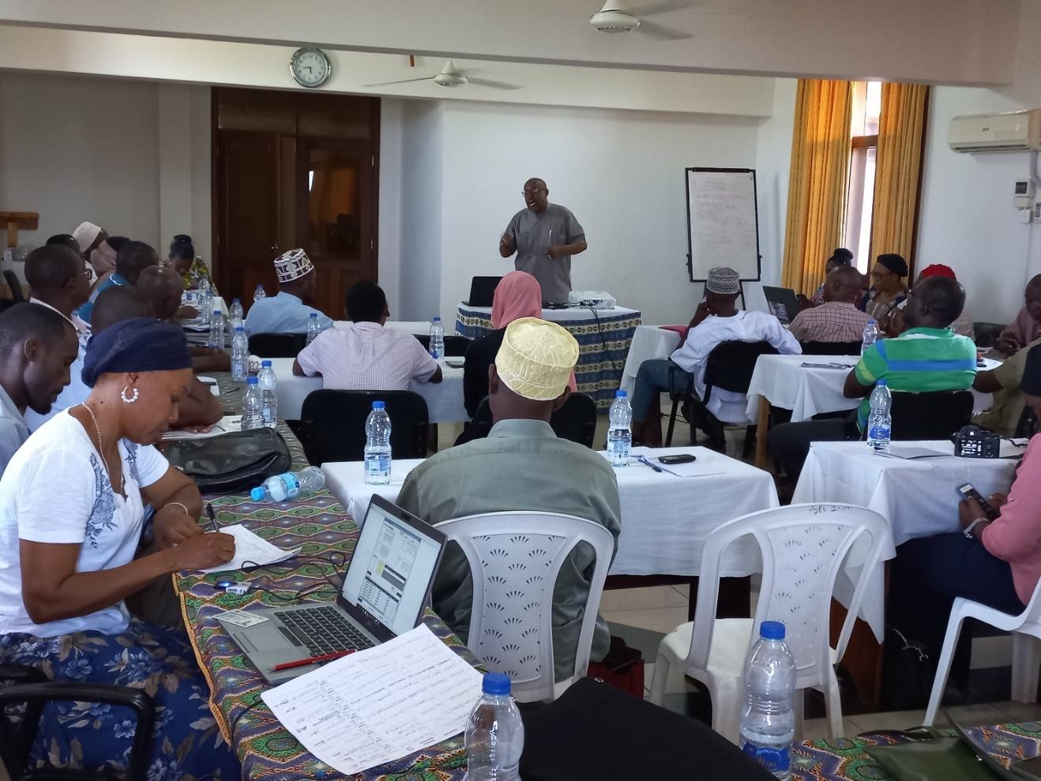
Hon Mayor A. O. Shiloo addressing key gatekeepers during FP orientation meeting in Tanga city
THANK YOU! ASANTENI SANA!

