Slide 1
Intergenerational Transfers and National Transfer Accounts
In honor of
Ronald Lee
2016 IUSSP Laureate
Notes:
Melissa and Sophia

Slide 2
Understanding the Generational Economy
Generational economy n
the social institutions and economic mechanisms used by each generation or age group to produce, consume, share, and save resources;
the economic flows across generations or age groups that characterize the generational economy;
explicit and implicit contracts that govern intergenerational flows;
the intergenerational distribution of income or consumption that results from the foregoing.
Lee research
Identifies the fundamental forces that govern the generational economy;
Advances our understanding of the real world in widely varying social, economic, and political contexts;
Addressed important policy issues related to changes in population age structure in the developing and developed world.

Slide 3
I. The Lifecycle: Working and Consuming
Work and its product and consumption vary with age governed by biology, culture, institutions, desires and needs, social and economic forces, and behavioral responses.
The result is a mismatch between consumption and labor income with extended periods of “dependency” at the beginning and, in contemporary societies, the end of life.
Notes:
The lifecycle has had enormous influence in economics and other social sciences. Seminal work on saving by Modigliani and intergenerational transfers by Samuelson relied on a primitive form of the lifecycle. Evidence now suggests that lifecycle research began much earlier than previously recognized.

Slide 4
First Known Depiction of the Lifecycle
Notes:
Note the puzzling features of the early life cycle: no children

Slide 5
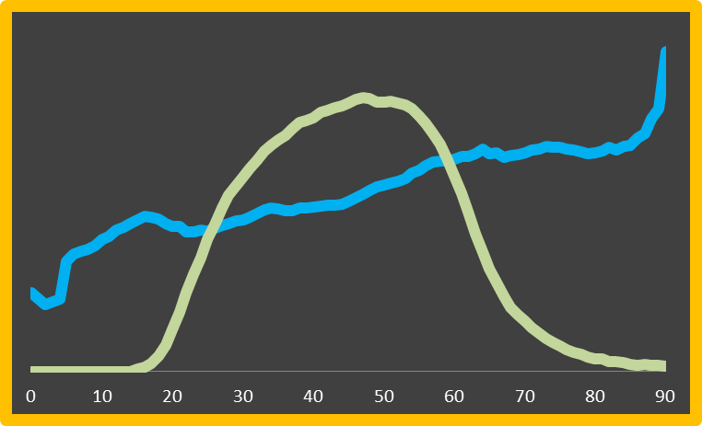
Lee Unearths the True Lifecycle

Slide 6
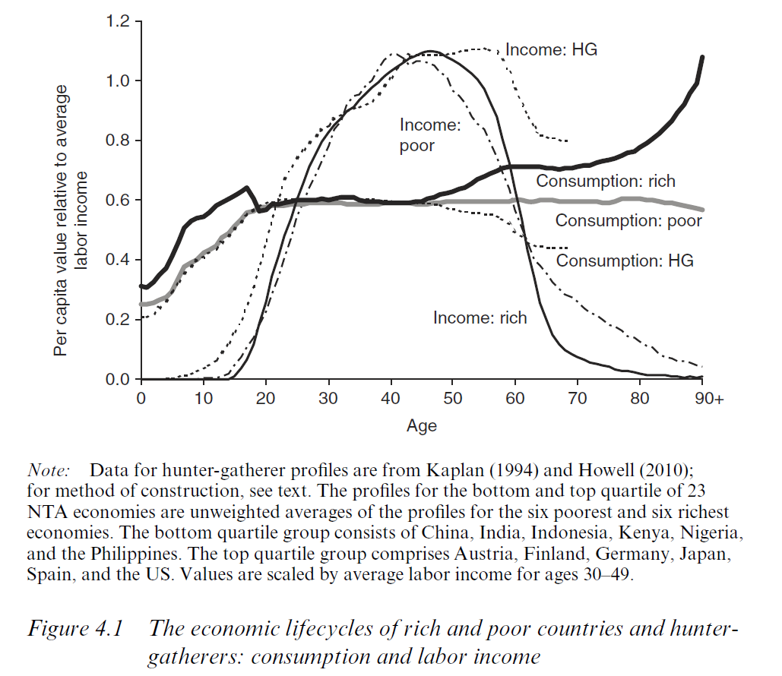

Slide 7
Forces that Influences the Lifecycle
Evolutionary forces
Institutional context
Existence of property: hunters and gatherers had no retirement.
Emergence of settled agriculture and property allowed us to accumulate wealth and “retire” (with the help of family members)
Development of financial markets (pension funds, 401Ks, etc.) reinforced
Development and expansion of government have led to an even more pronounced lifecycle with increasing public support for children and the elderly.

Slide 8
Forces that Influences the Lifecycle
Demography
Quantity-quality tradeoff: as number of children declines private spending, particularly human capital spending, per child increases.
Public Q-Q tradeoff: as child dependency declines, per capita public spending on human capital increases quite sharply.
Preston effect: not apparent in NTA data (but it is early yet)

Slide 9
Forces that Influences the Lifecycle
Emerging contemporary patterns
Extended period of youth dependency due to education and emergence of NEETs
Early retirement, but some signs of reversal
High consumption among older adults and the elderly in high income countries

Slide 10
II. Age Reallocation System: Sharing and Saving
Age reallocations are the counterpart to the economic lifecycle
Lifecycle deficits at young and old ages must be funded relying on sharing and saving.
Sharing or intergenerational transfers
Private, mostly familial based, transfers
Public transfers consisting of taxes and spending
Saving: an outflow at one age that leads to future inflows at other ages in several forms:
Asset income
Dis-saving
Bequests
Borrowing is negative saving that yields a current inflow and obligates a future outflow.

Slide 11
Lee Discovers Arrows

Slide 12
Why Lee Arrows are Cool
Provide a comprehensive and coherent way of summarizing any age reallocation
Annual flow
Age of origin and destination
Direction of the flow
Under idealized circumstances
Approximately so in less idealized conditions

Slide 13
Lee arrows, transfer flows and wealth

Slide 14
Lee tells us our future . . .
. . . and our past

Slide 15
Public Transfers and Generational Equity
Public transfer systems (education, health, and pensions) in the US have benefited all but the 1941-49 birth cohorts.
Even the descendants of all those alive today are likely to benefit from public transfer systems.
The costs will be imposed on those who will not be born for decades.

Slide 16
Demographic Dividends and Standards of Living
Changes over the demographic transition provide a transitory boost to standards of living.
And potentially important and persistent effects through investment and human capital channels.
Moderately low fertility will strain public finances, but favor standards of living.

Slide 17
Lee’s Global Reach National Transfer Account Network

